Slide 1


Report on Working of Ward Committees in the City of Mumbai and Civic Problems Registered by Citizens
(January 2012 to December 2013)
Supported by:
FORD FOUNDATION

Slide 2

Number of questions asked by Councillors in Ward Committees during March’12 to December’13
Category | No. of Members
 | Mar’12 to Dec’12 | Mar’13 to Dec’13 | Jan’13 to Dec’13
Zero Question | 45 | 28 | 19
1 to 5 Questions asked | 148 | 145 | 142
6 to 10 Questions asked | 31 | 43 | 54
Above 10 Questions asked | 3 | 11 | 12
Total Members | 227 | 227 | 227
Number of Councillors who did not ask any questions has decreased from 45 during March’12-December’12 to 28 in March’13-December’13.
Number of Councillors who asked more than 10 questions have increased from 3 during March’12-December’12 to 11 in March’13-December’13.

Slide 3
Total numbers of Meetings, Attendance and Questions during Mar’12 to Dec’13
Ward Committee
Year | Total Meetings | Attendance in (%) | Total Questions
Mar’12 to Dec’12 | 209 | 82% | 678
Mar’13 to Dec’13 | 215 | 79% | 852
Jan’13 to Dec’13 | 265 | 79% | 988

Slide 4
Attendance of councillors decreased by 3% from Mar’12 – Dec’12 to Mar’13 – Dec’13.
Questions asked by councillors increased by 26 % from Mar’12 – Dec’12 to Mar’13 – Dec’13.

Slide 5
Issue-wise Number of Questions asked in Ward Committees during Mar’12 to Dec’13
Issues | Questions asked (Mar’12 to Dec’13)
 | Mar’12 to Dec’12 | Mar’13 to Dec’13 | Jan’13 to Dec’13
Drainage | 30 | 27 | 34
Solid Waste Management (SWM) | 62 | 82 | 85
Water Supply | 47 | 38 | 44
License | 29 | 39 | 50
Roads | 102 | 114 | 141
Storm Water Drainage | 31 | 45 | 51
Toilet | 19 | 18 | 22
Pest control | 11 | 12 | 13
Garden/Open space | 28 | 37 | 38
Community Development | 13 | 27 | 29
Health | 19 | 17 | 18
Education | 19 | 26 | 29
Naming/Renaming of Roads/Chowks | 127 | 126 | 147
Other issues related | 141 | 244 | 287
Total | 678 | 852 | 988
Highest number of questions (147) were asked on Naming/Renaming of Roads/ Chowks in year January 2013 to December 2013.
12% increase in Councillors asking questions on roads from Mar’12 – Dec’12 to Mar’13 – Dec’13.

Slide 6
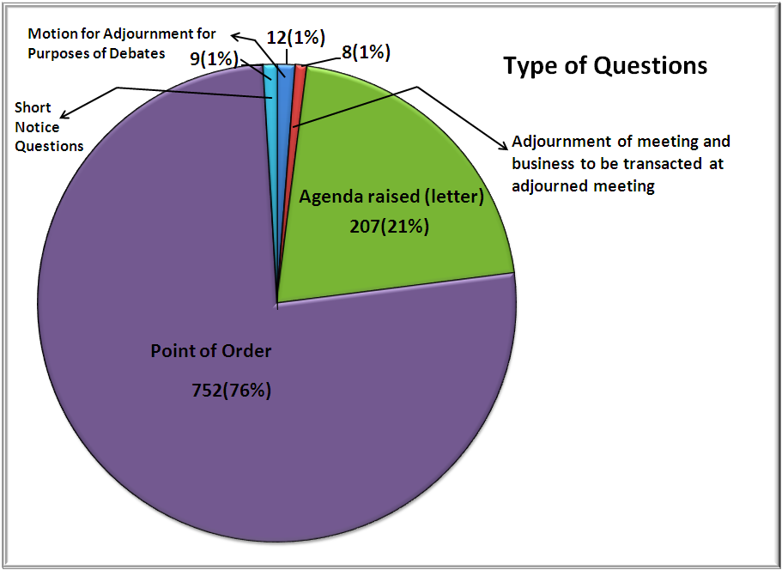
Type of devices used by councillors in year 2013
Out of 207 ‘Agenda Raised’ Questions, 147(71%) were on Naming/Renaming of Roads /Chowks
Out of a total 988 questions, 752(76%) were Point of Order questions.

Slide 7
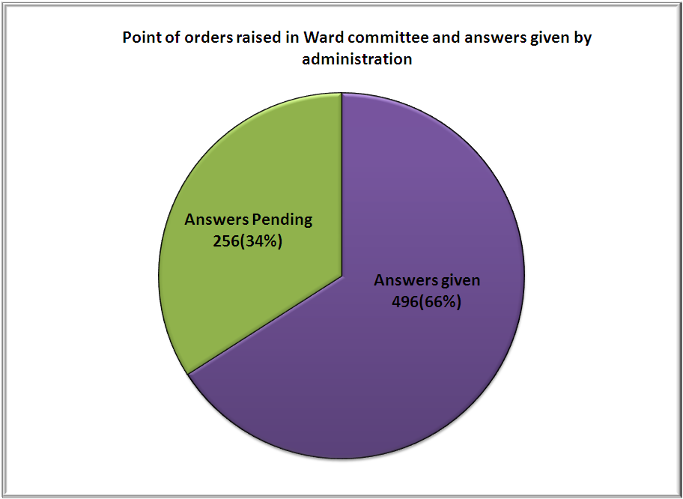
Answers given by Administration to Point of Order questions raised in Ward committee meeting in Year 2013
Out of 752 point of orders, Administration has given answers to only 496 (66%) and 256 (34%) Point of Orders are pending.

Slide 8
Praja’s Impact

Slide 9
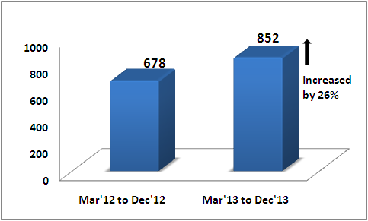
Number of total questions in Ward Committee has increased by 26%

Slide 10
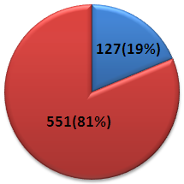
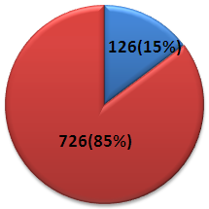
Number of questions asked on ‘Naming/Renaming of Roads/Chowks’ have decreased by 4% out of total questions asked between Mar’12 - Dec’12 to Mar’13 – Dec’13
Mar’12 to Dec’12
Mar’13 to Dec’13

Slide 11
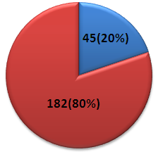
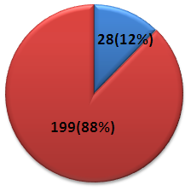
Number of councillors asked zero questions have come down 45 to 28 between Mar’12-Dec’12 to Mar’13- Dec’13
Mar’12 to Dec’12
Mar’13 to Dec’13

Slide 12
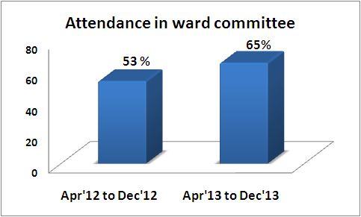
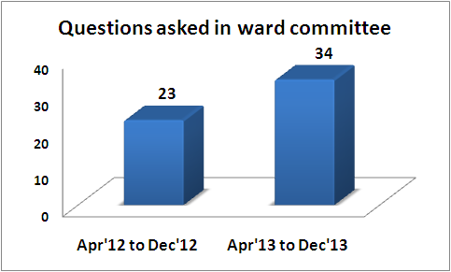
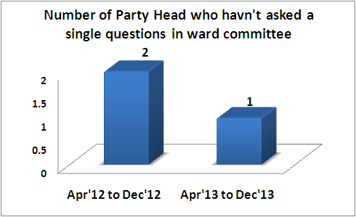
Party Head in Ward Committee Meeting

Slide 13
What Needs to be Done
Functioning of Ward Committees needs to be strengthened. This can happen only through effective deliberation by councillors, on constituency-wise civic issues, using appropriate devices in Meetings.
Councillors need to study civic issues pertaining to their constituency, prepare their agendas and push these in the Committee meetings in a planned way.
Councillors need to follow up with the Administration regularly and demand answers.
Coucillors need to demand from Administration monthly report of Citizens’ Complaints in the Ward Committee meetings.

Slide 14
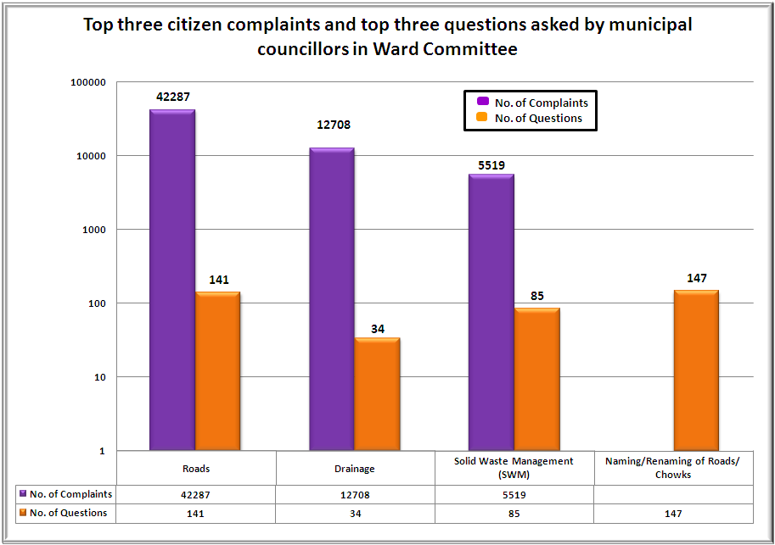
Comparison between top three citizen complaints and top three questions asked by municipal councillors in the Ward Committees in calendar year 2013
While the issue most affecting citizens was Roads (42,287 complaints), our Municipal Councillors were more focused on raising the issue of ‘Renaming of roads/chowks’, with maximum number of questions (147) asked on the latter.

Slide 15
Top Four Civic Complaints in Mumbai during 2012 & 2013
Issues | Complaints |  | Increase from 2012 to 2013 (in %)
 | 2012 | 2013
Roads | 29967 | 42287 | 41.1%
Drainage | 16194 | 12708 | -21.5%
Solid Waste Management (SWM) | 6562 | 5519 | -15.9%
Water Supply | 6215 | 6075 | -2.3%
Other Complaints | 33891 | 35799 | 5.6%
Mumbai | 92,829 | 102,388 | 10.3%
The increase in Road related complaints is primarily due to the new Potholes complaint system developed by the Corporation. This only emphasises the need for a technologically advanced, centralised, user-friendly and effective complaints redressal mechanism.

Slide 16
Civic complaints on ‘Potholes on the Roads’ in the Calendar Years 2012 and 2013
Potholes on the Roads
Central Complaint Registration System (CCRS) |  | Increase from 2012 to 2013 (in %) | Voice of Citizens |  | Increase from 2012 to 2013 (in %) | Total
2012 | 2013 |  | 2012 | 2013 |  | 2012 | 2013
1757 | 1804 | 3% | 24414 | 36475 | 49% | 26171 | 38279
The above data presents the number of complaints registered on Central Complaint Registration System (CCRS) and MCGM’s Portal (http://www.voiceofcitizen.com) of Pothole tracking software across the wards for the years 2013.

Slide 17
Ward-wise status report of complaints in year 2013
Ward | Total Complaints | Closed (Action taken) | Complaint Registered (Action Pending) |  | In Process (Not assigned/Re Assigned/Being Attended) | Not related to MCGM | Councillor code given
 |  |  | No. | In (%) |  |  | No. | In (%)
A | 1184 | 790 | 365 | 31% | 28 | 1 | 131 | 11%
B | 1436 | 499 | 912 | 64% | 25 | 0 | 270 | 19%
C | 1609 | 617 | 982 | 61% | 10 | 0 | 249 | 15%
D | 2796 | 1393 | 1219 | 44% | 184 | 0 | 223 | 8%
E | 1881 | 894 | 964 | 51% | 23 | 0 | 241 | 13%
F/N | 1671 | 515 | 1130 | 68% | 26 | 0 | 254 | 15%
F/S | 1021 | 482 | 510 | 50% | 27 | 2 | 194 | 19%
G/N | 2747 | 1571 | 719 | 26% | 456 | 1 | 360 | 13%
G/S | 1727 | 841 | 874 | 51% | 12 | 0 | 229 | 13%
H/E | 2090 | 498 | 1538 | 74% | 53 | 1 | 308 | 15%
H/W | 2436 | 1166 | 1251 | 51% | 19 | 0 | 379 | 16%
K/E | 4606 | 2186 | 2314 | 50% | 104 | 2 | 645 | 14%
K/W | 6539 | 1505 | 4908 | 75% | 126 | 0 | 870 | 13%
L | 7095 | 2863 | 4215 | 59% | 15 | 2 | 518 | 7%
M/E | 4005 | 2415 | 1572 | 39% | 17 | 1 | 319 | 8%
M/W | 2653 | 1812 | 839 | 32% | 2 | 0 | 268 | 10%
N | 2819 | 1037 | 1759 | 62% | 23 | 0 | 400 | 14%
P/N | 3986 | 2728 | 1193 | 30% | 64 | 1 | 414 | 10%
P/S | 2719 | 1385 | 1331 | 49% | 3 | 0 | 282 | 10%
R/C | 2752 | 849 | 1835 | 67% | 68 | 0 | 345 | 13%
R/N | 1395 | 312 | 1066 | 76% | 17 | 0 | 339 | 24%
R/S | 3344 | 1639 | 1687 | 50% | 18 | 0 | 314 | 9%
S | 2265 | 714 | 1438 | 63% | 113 | 0 | 401 | 18%
T | 1137 | 571 | 555 | 49% | 7 | 4 | 199 | 18%
Total | 65913 | 29282 | 35176 |  | 1440 | 15 | 8152
In (%) |  | 44% | 53% |  | 2% | 0.02% | 12%

Slide 18
What needs to be done
Emphasis on the need for a technologically advanced, centralised, user-friendly and effective complaints redressal mechanism
Integration of all complaint portals with Centralised Complaint Registration System (CCRS).
Officers need to include an ACTION TAKEN REPORT (ATR) on the complaints, which should include the councillor code number to track down the officer who has/should have resolved the complaint. ATR should be shared with the complainant.
Complaint should be closed only after satisfaction of the complainant.
A robust Standard Operating Procedure (SOP) needs to be adopted and strictly followed by the administration for redressing complaints.
Citizens need to participate more actively by using grievance systems and pressurise the Municipal Corporation to provide better civic services.

Slide 19
THANK YOU !!!

